Slide 1


Slide 2
Market integration in the CEE countries
Czech – Austrian trading region
GRI SEE
08 July 2016, Budapest
Notes:
RO-HU-AT - a pilot project for incremental capacity
How to develop functioning markets?
Infrastructure needs and initiatives for Europe
RO-HU-AT - a key project for Central and South-East Europe

Slide 3




Market integration
First integration idea in the
CEE countries in 2011-
CEETR Project
CZ - AT market integration

Slide 4
Czech-Austrian market integration
Joint working group between the involved NRAs (ERÚ and E-Control) and the TSOs (Net4Gas, GCA and TAG) established in 2014
  Various market integration models have been analyzed
    Market connection via new IP Reintal
    Trading Zone with separate VTPs
    Trading Zone with common VTP
    Trading Region
4

Slide 5
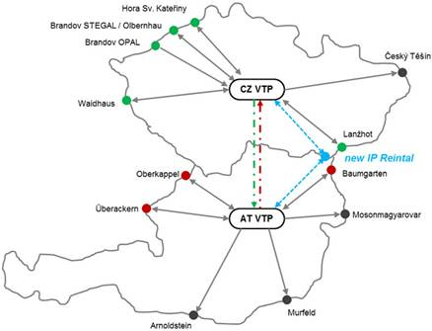
Czech-Austrian market integration
Objective: close integration of Czech and Austrian gas markets
  Market survey
  in Q2 2015
  indicated
  preference for
  market integration
  as compared to a
  classical market
  connection (i.e. new IP)
5

Slide 6

Envisaged model
Lanžhot
Český Těšín
Baumgarten
Mosonmagyarovar
Hať IP (STORK II)
Czech Republic
Republic of Austria
South Stream IP
Ind. Production
Ind. Production
Brandov (STEGAL)
Murfeld
Olbernhau/HSK
Common VTP
Brandov (OPAL)
Arnoldstein
Balancing
N4G
GCA
Gas Exchange
PXE (futures) / OTE (SPOT)
CEGH (both)
Überackern
Waidhaus
AT-CZ Trading Region
Oberkappel
TSOs level
DSOs level
VBP_{CZ}
VBP_{AT}
Balancing
OTE
Balancing
AGCS
End-user Zone CZ
End-user Zone AT

Slide 7
What to do?
TRU
Insufficient interconnection capacity does not allow for a market integration ?

Slide 8
What to do?
Trading region upgrade (TRU)
solution to better connect CZ and AT markets
TRU

Slide 9
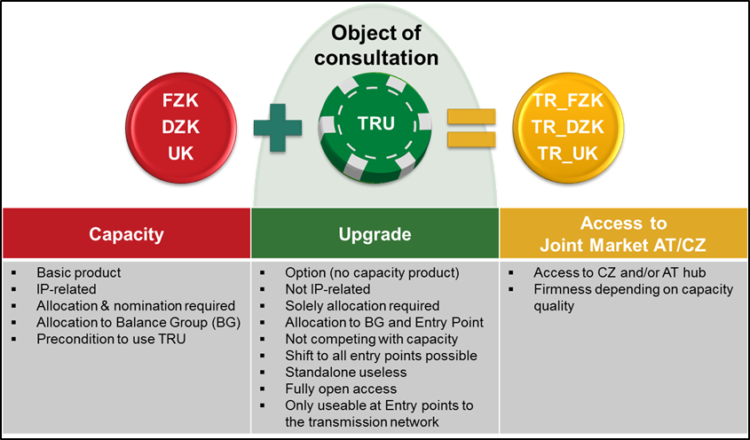
Trading Region Upgrade (TRU)

Slide 10



Trading region upgrade
VTP CZ
VTP AT

Slide 11


Trading region upgrade
VTP CZ
VTP AT

Slide 12
Trading region upgrade
VTP CZ
VTP AT

Slide 13
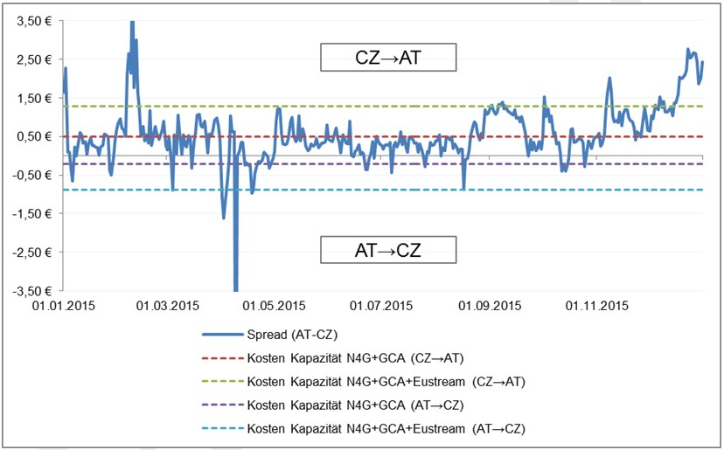
Spread AT-CZ and capacity costs on yearly basis
Source: Wagner Elbling & Comp.

Slide 14
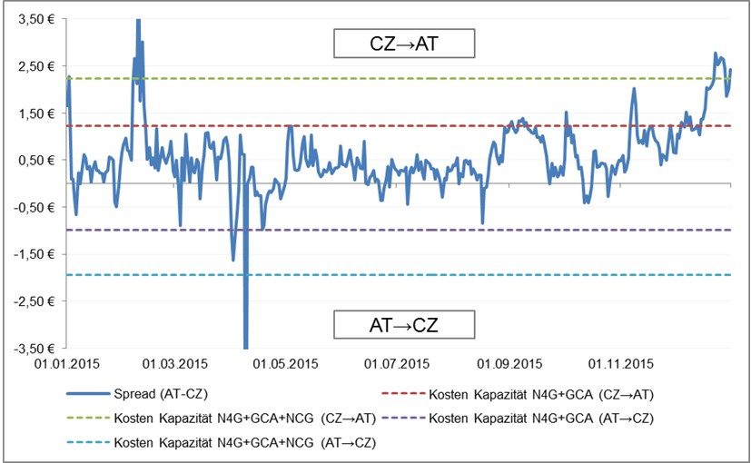
Spread AT-CZ and capacity costs on day-ahead basis
Source: Wagner Elbling & Comp.

Slide 15
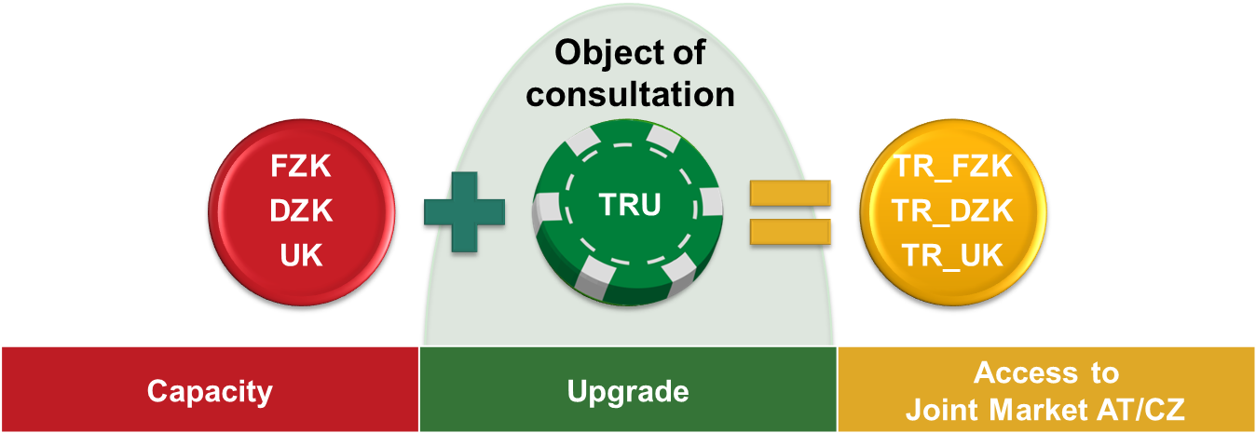
Consultation revealed interest
Consultation on TRU took place in April 2016
Consultation showed general support but triggered several questions
Next steps
  Answering questions raised (July 2016)
  Stakeholder event after the summer

Slide 16
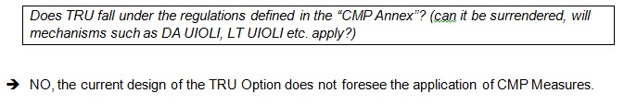
…answers to questions

Slide 17
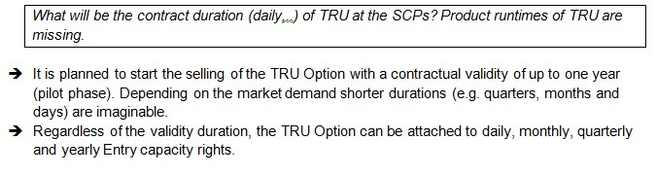
…answers to questions

Slide 18

…answers to questions

Slide 19
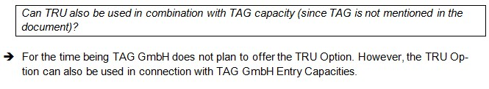
…answers to questions

Slide 20
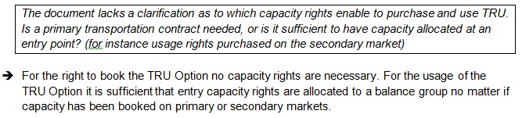
…answers to questions

Slide 21
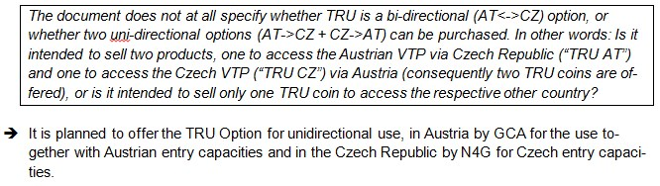
…answers to questions

Slide 22

…answers to questions

Slide 23
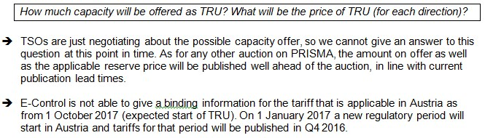
…answers to questions

Slide 24
Conclusion
TRU consultation revealed interest
2016 Q3 aswers to FAQ
2016 Q4 stakeholders event
2017 TRU will be offered (?)
Implementation steps to follow

Slide 25
Contact
Alessandro Ischia
 + 43 1 24 7 24 810
 alessandro.ischia@e-control.at
☒ www.e-control.at

